Slide 1
Behrend
First semester for compsci, sweng, and compeng

Slide 2

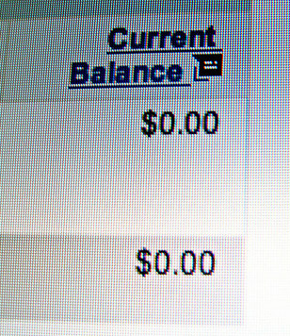
Money
Behrend is about 7.5k per semester
5k for residence
Commuting
I got ~3k in scholarships
Having a job will affect your grades
GPA 3.6 minimum for academic scholarships
96k Federal unsubsidized 6.54%, 7.54%
Private 12%
6.28k - 11.52k thousand per year in interest

Slide 3

scholarships
Erie community foundations: -semi competitive
  https://www.eriecommunityfoundation.org/scholarships
Mykaleidoscope -competitive
  https://www.mykaleidoscope.com/for-applicants/
Local VFW’s & churches -not competitive
Us government:
  https://studyabroad.state.gov/us-government-scholarships-and-programs/us-college-and-university-students
Clubs & communities (ex gardening club 1k) -not competitive
Behrend/whatever college you are going to is gonna have minimum 40 scholarships -semi competitive
Fast food scholarships -semi competitive
Google, Amazon, Tacobell, all have very competitive scholarships

Slide 4
Grades (do)n’t matter, but do in college
Don’t torment yourself over grades, previous grades are sunk costs
They are difficult
Behrend has a 89% acceptance rate
Average gpa 3.3
Ultimately other than learning more about the major you pick college is about getting a job.
Must have a 3.0 minimum for an internship
Clubs matter: CompSci club, robotics, Behrend ambassadors, triangle-fraternity…etc
  Networking
You need to be good in what you learned for 12 years in school
Study for your sat

Slide 5

Try to learn
No other generation has had the opportunities we have now with the internet
The first math class you take has to be calculus 1 if you want to graduate in 4 years
Highschool teachers are legitimately bad, professors are a better
https://github.com/codecrafters-io/build-your-own-x
https://www.youtube.com/@freecodecamp
https://www.khanacademy.org/

Slide 6
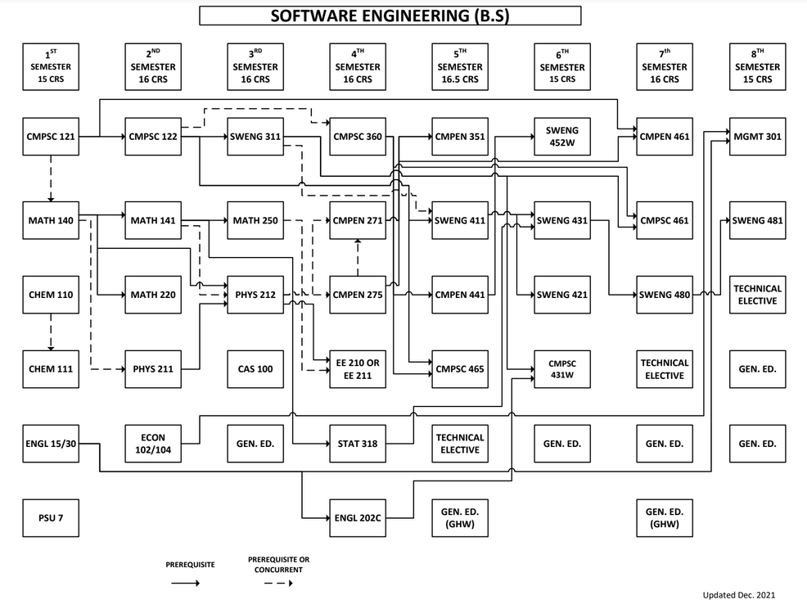

Slide 7
First semester compSci classes is this class
C++
Start at cout << “Hello World” << endl;
End with classes & pointers
The professors are not as good as Mr.K
  They don’t like it whenever you say you don’t understand something or ask for help

Slide 8
Know your major
You have to pick your major (that makes money) and stick with it
This is about making yourself more valuable
Way more options than college, trades, etc
You are not going to love your job/choice of study

Slide 9
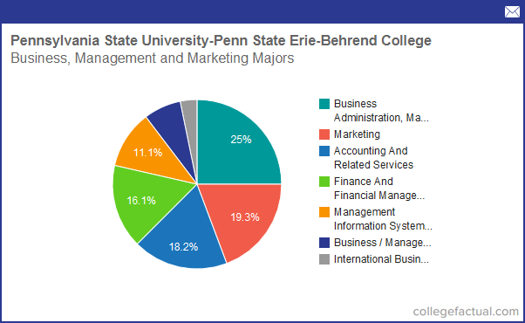
Why behrend
Behrend is local, close, affordable, prestigious
Launchpad, you can go to any campus in PA
Knowledge park/opportunities/career fairs
31’st in engineering nationally, Penn state in general is 7th in the nation

Slide 10
The reality of ECTS for programmers
This place is more of an opportunity than you think
The only reason to go here should be that you actually want to learn to code
No one cares unless you have proof
Code portfolio
There is a tutorial for everything
  https://github.com/codecrafters-io/build-your-own-x

Slide 11
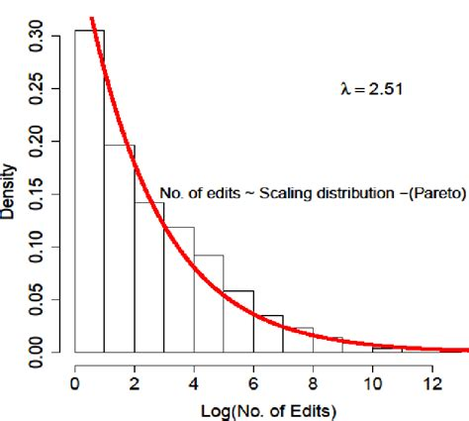
Life advice
Fix your sleep schedule
Write out everything you need to do before you start your day, be realistic
Active recall
Have focus in your life
Understand that companies/schools don’t see you as a person
Understand sunk costs
If you try, you will eventually find what you are suppose to be doing
Every day if you try your best
Make the today 1% better than yesterday

Slide 12
questions

